Slide 1

VuePress
Vue-Powered Static Site Generator

Slide 2


Team Members
Ujjawal Kumar
Vijay Tupakula
Anurag Kumar
Sai Sirisha Devineni

Slide 3
Another js technology?
🤯

Slide 4
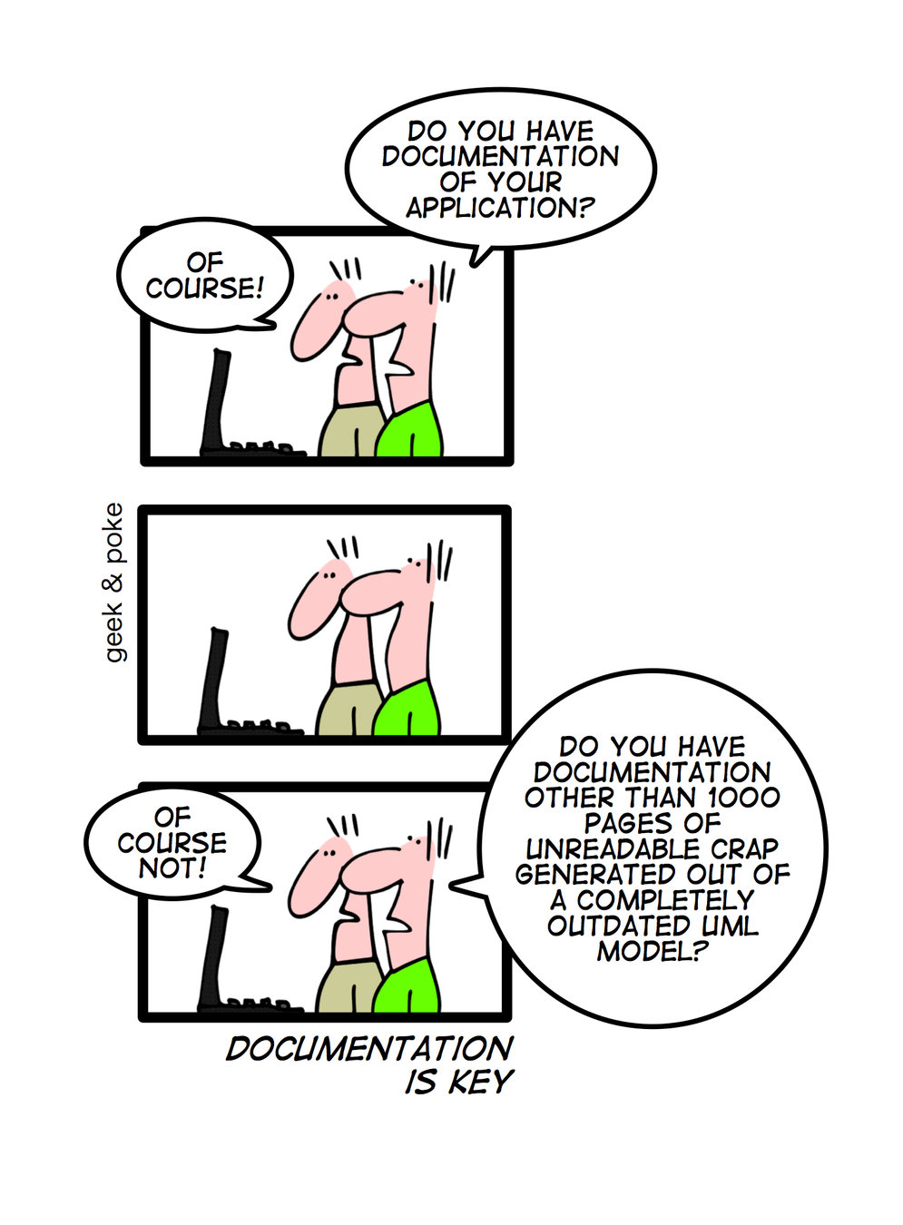

Slide 5
Documentation can be difficult, but it is the key to any project’s long term success

Slide 6
Build your own
What tech stack do you use? 🤨
What does the design look like? 😟
What features should it have? 😞
Is it easy to maintain? 😅
Who is going to pay for this? 😏

Slide 7
Living & Good Documentation is HARD

Slide 8
Enter VuePress

Slide 9
Introduction
VuePress is composed of two parts:
A minimalistic static site generator with a Vue-powered theming system,
A default theme optimized for writing technical documentation.
It is SEO friendly.
It acts as Single-Page Application (SPA) and other pages are rendered as the user navigates around the site.
Sai Sirisha Devineni

Slide 10




What makes VuePress great?
Default Theme
Already known technologies😍
Write in Markdown language
Built in Markdown Extensions
Generates Static HTML
Built in PWA🤗
Ujjawal Kumar

Slide 11
Default Theme Features
Home Page
Nav Bar
Side Bar
Built-in Search
Git Repo
Last Updated & Edit Links
Ujjawal Kumar

Slide 12
Things you need to know
npm install / npm run dev 😄
Markdown syntax 😍
Git 😸
… That’s it 😇

Slide 13
Cool Markdown Extensions
Emojis 😇😍😁😸🤫
Front Matter
GitHub-Style Tables
Code Syntax Highlighting
Line Highlighting in Code Blocks

Slide 14
Secret 🤫 it supports vuejs components

Slide 15
Demo
Vijay Tupakula

Slide 16
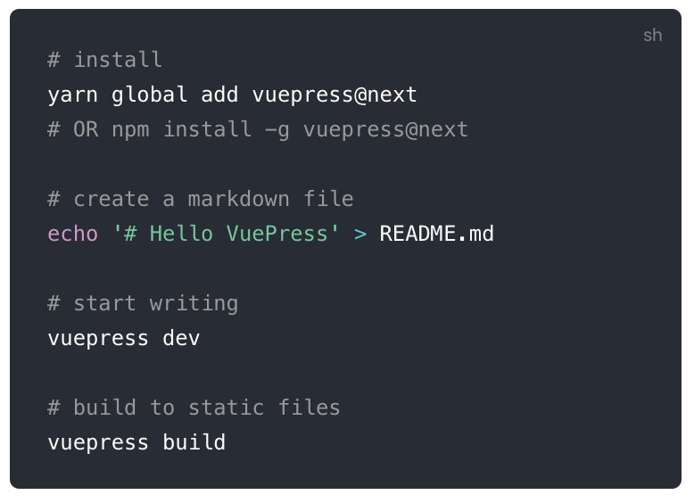

Slide 17
https://vuepress.vuejs.org/

